Slide 1
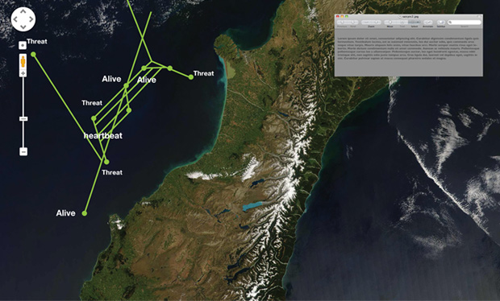
Vehicle Tracking System
The Challenge
The Navy and DARPA needed to track and monitor hundreds of vehicles in real-time, while representing their position and status indicators through visual interfaces. Affirma was engaged to help solve this problem by collecting and storing relevant data, ultimately showing personnel these vehicles’ locations on a real-time basis.
What We Did
Affirma developed a network-centric web service that was installed on Navy ships. Data from the vehicle’s control systems was collected on board the ship and synchronized with data from other ships in a central data repository. Data collected on board the ship was stored in a SQL Server database, transmitted to shore and synchronized with data from other ships remotely, in the cloud. Affirma created multiple visualization and 3D visual tools to allow for intuitive, user-friendly interpretation of data.
Results
Navy personnel can quickly and easily track the position and status of these vehicles in real-time. The Navy is extremely pleased with the system as it met and exceeded its core functionality.

